Slide 1
Spring 2016 Capstone
Maurice Shorter & Amber Matthew

Slide 2
Our Project
Using the Phaser engine we created a 2 dimensional platformer
There’s a character sprite that is controllable
There are other non-controllable units that should be able to interact with with the character by making the player lose hp if the MC collides with the enemy.
The player can kill enemies by jumping on them or by shooting the flies with a fireball on the first level.

Slide 3
Schedule of Work
Pre Revamp
We were working with Unreal Engine where we had a lot of setbacks, so our schedule was not consistent. The only notable work up till March 28th was the ability to walk, run, spin, and some rudimentary collision success.
Post Revamp: March 28
Week 1: Created and displayed a user sprite sheet able to be displayed. (M)
Week 2: The character was able to jump, walk, and run. (M)
Week 3: Character was able to exist on the screen with other units. (Mosquitoes and Flies) (M)
Week 4: Tile set interaction implemented. (A)

Slide 4
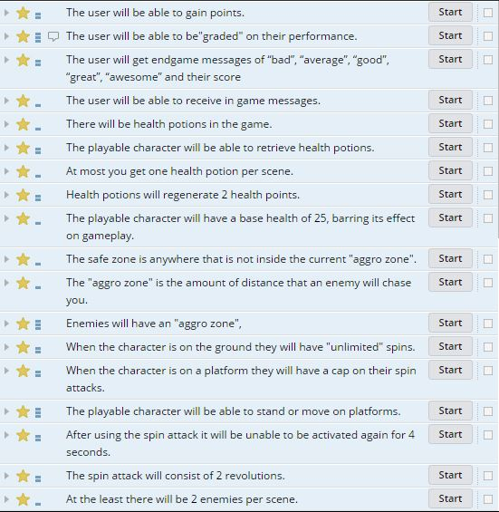
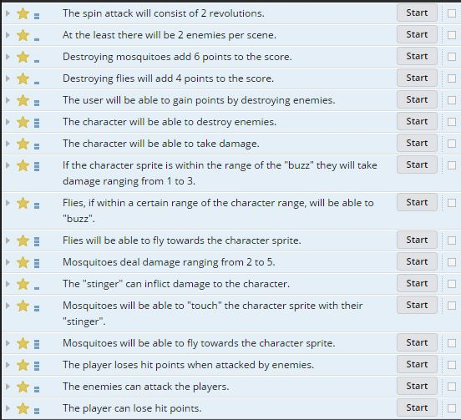
Things We Planned to Do but Didn’t

Slide 5
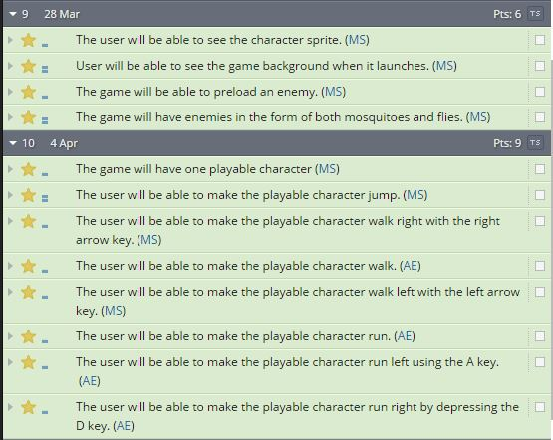
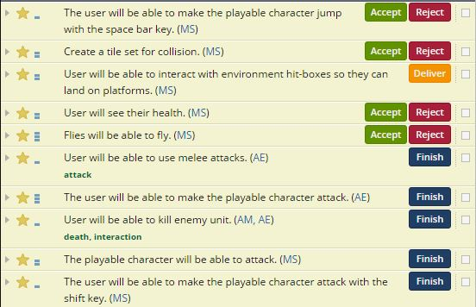
Things We Actually Did

Slide 6
What We Learned
Maurice
Just because you enjoy something doesn’t mean you’ll be good at it.
Math will haunt you til you die.
Team collaboration isn’t easy.
Fixing one thing will usually break another
Present what’s working, not something that should work
Amber
I learned how to use phase.
I also learned how to make tile maps to make games.
The most important thing I learned at this time is not to be too “hopeful”

Slide 7
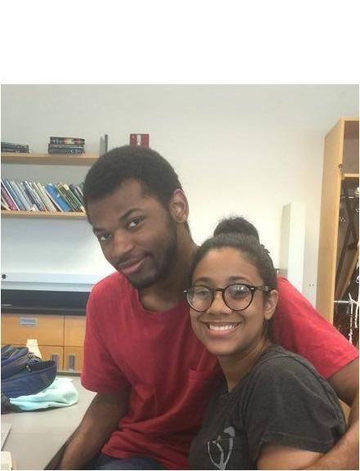
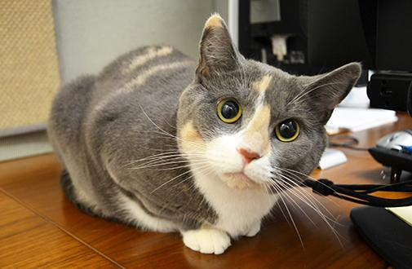
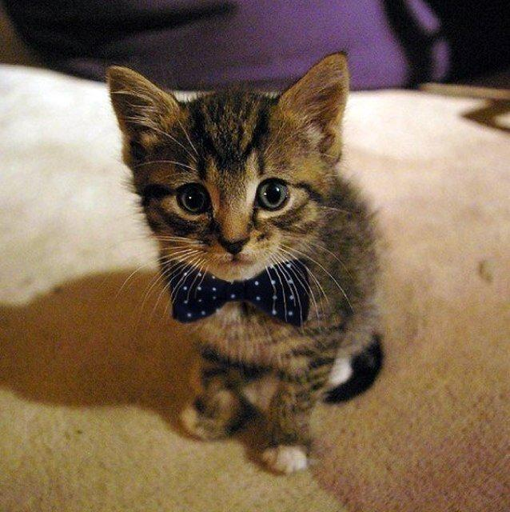
A Few Years Later - Maurice
Personal
Still be in contact with some good friends
Cats
Pursuing Master’s degree
Job
Still learning
Master’s degree at least
Promoted and relocated
Leading a team (?)
Not unemployed
Maybe something in machine learning or the government

Slide 8
Back to day 1 - Maurice
More research
Less worrying
Maybe more social, doubt it, but maybe
More NSBE conferences
Try to spend less money on food
Be a more proactive student (go to office hours and talk to some teachers)
Skip way less class

Slide 9
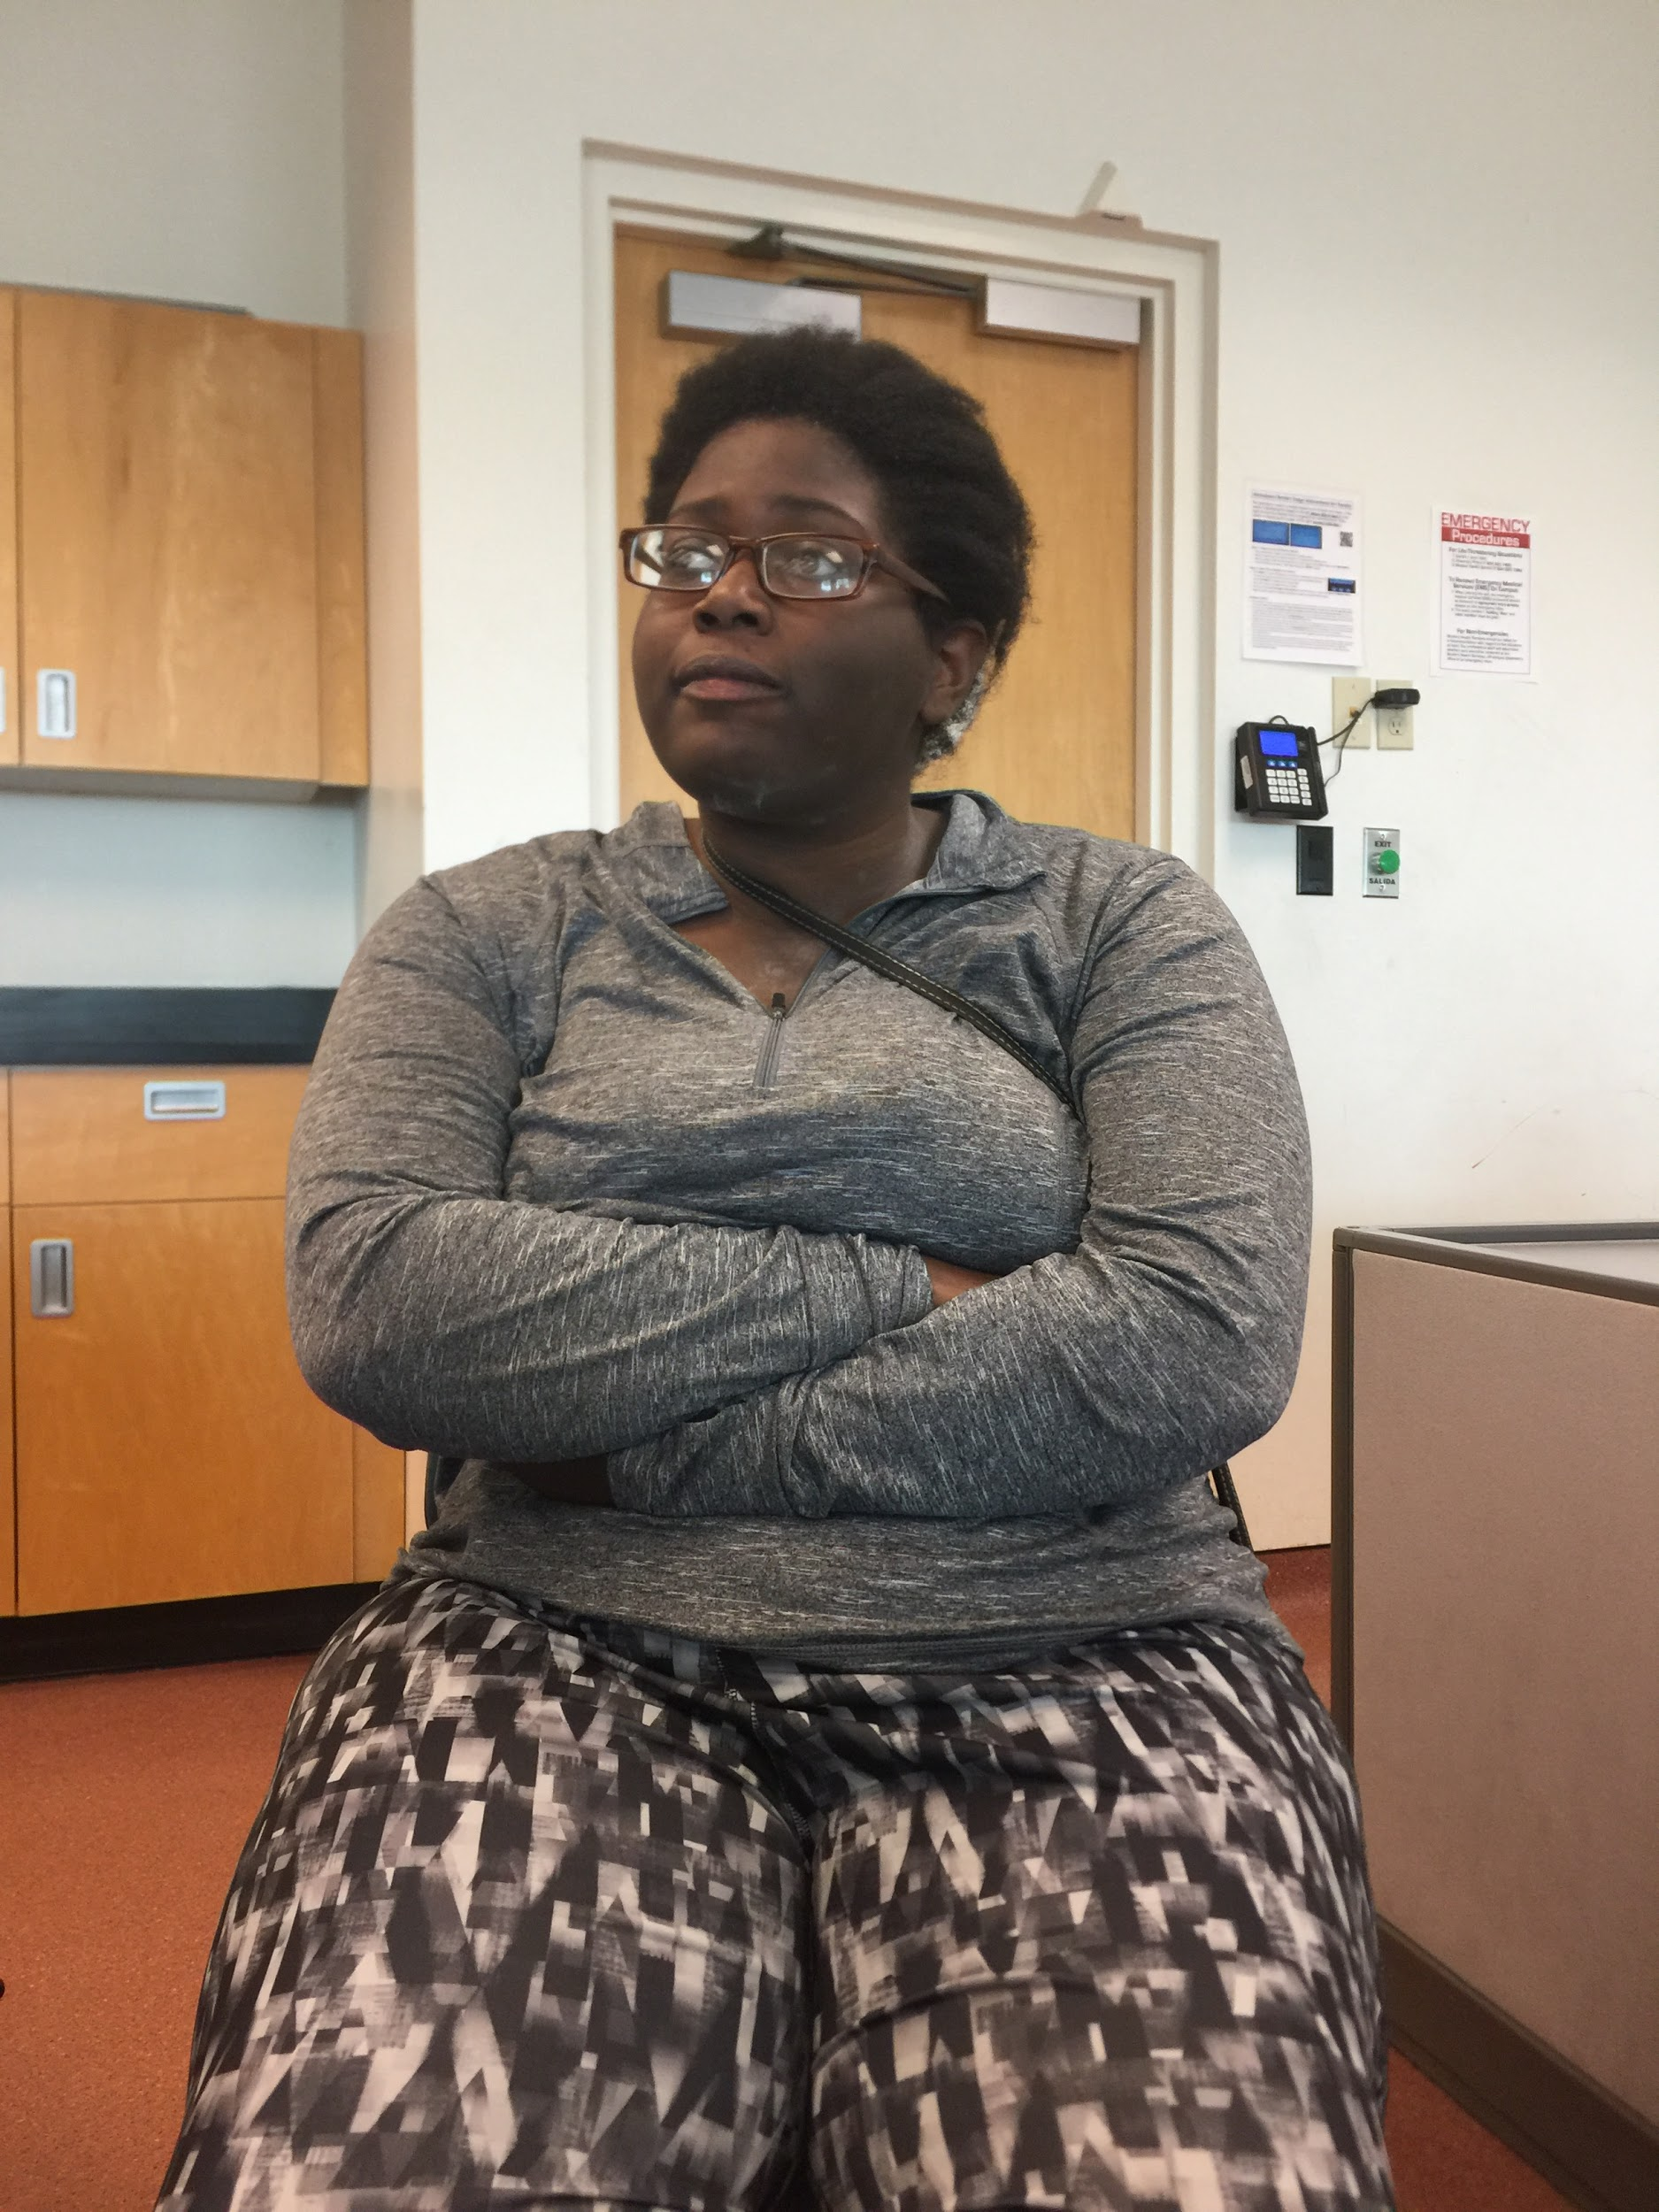
A Few Years Later - Amber
Making Apps in my freetime
Retirement

Slide 10
Back to Day One -Amber
Our first project specs were a little too much so we had to revamp on March 28th which involved a change in engine and language. I would have researched more options.

